Slide 1

Medical Wristband Body Temperature Monitor
Problem Contextualisation Oral Presentation
JH van Dyk
30254906

Slide 2
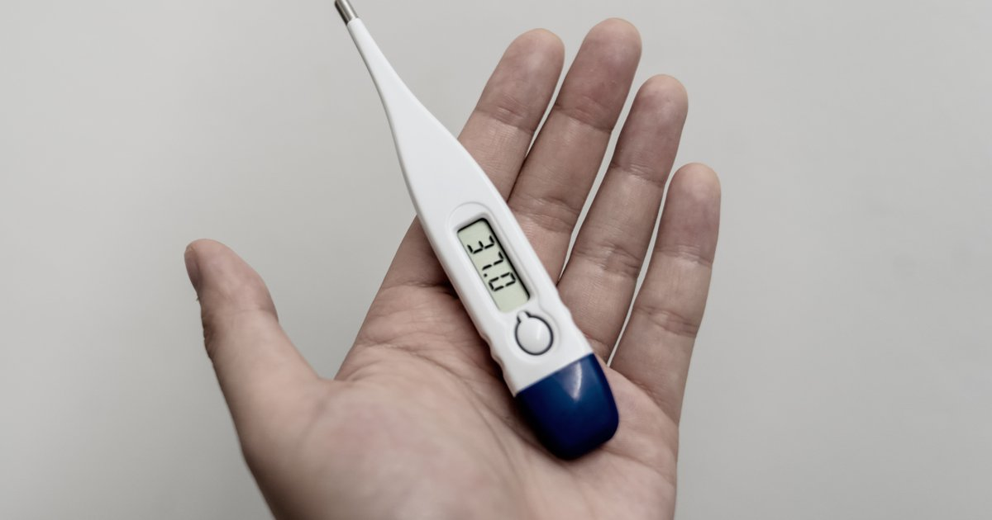
Overview
Body temperature directly affects one’s physical health.
Human body temperature is regulated at 37°C ± 1°C.
Several diseases are characterised by body temperature.
Body temperature measurements are used to analyse the effectiveness of treatment.
Available at:
https://www.google.com/url?sa=i&url=https%3A%2F%2Fwww.phillyvoice.com%2Fnormal-body-temperature-range-covid-19-%2F&psig=AOvVaw1I0tmvPjyq1093VVi831pC&ust=1615492974926000&source=images&cd=vfe&ved=0CAIQjRxqFwoTCNitysXCpu8CFQAAAAAdAAAAABAE

Slide 3
Background & Context
Invasive vs. Non-Invasive.
Various devices already exist that can measure body temperature.
Oral Thermometer.
Tympanic Thermometer.
Mercury-in-glass / alcohol-in-glass.
Infrared Thermometer.
Each category of devices has advantages and disadvantages.

Slide 4

Problem statement
A body temperature measuring device is needed that:
Measure core body temperature.
Is non-invasive, without measurements getting affected.
Is simple and comfortable.
Hypothesis:
A wristband that can measure body temperature.
Available at:
https://www.google.com/url?sa=i&url=https%3A%2F%2Fwww.ehstoday.com%2Fsafety-leadership%2Fsafety-problem-solving-incredible-effort-improve-past&psig=AOvVaw1OuXz2NcrEZIpIRr5xA4E2&ust=1615493330953000&source=images&cd=vfe&ved=0CAIQjRxqFwoTCPinhevDpu8CFQAAAAAdAAAAABAD

Slide 5

Project objectives
Primary objectives:
Development of a body temperature measuring wristband that can accurately measure core body temperature, whilst being:
Simple
Low-cost
Lightweight
Energy efficient
Thermal equivalent circuit model optimisation.
Secondary objectives:
Human-Machine Interface.
Available at:
https://www.google.com/url?sa=i&url=http%3A%2F%2Fidol-portfolio.weebly.com%2Fchapter-6.html&psig=AOvVaw0yVyeHmemRcP2KWCsjbGcH&ust=1615493426734000&source=images&cd=vfe&ved=0CAIQjRxqFwoTCIDe_JXEpu8CFQAAAAAdAAAAABAa

